Slide 1
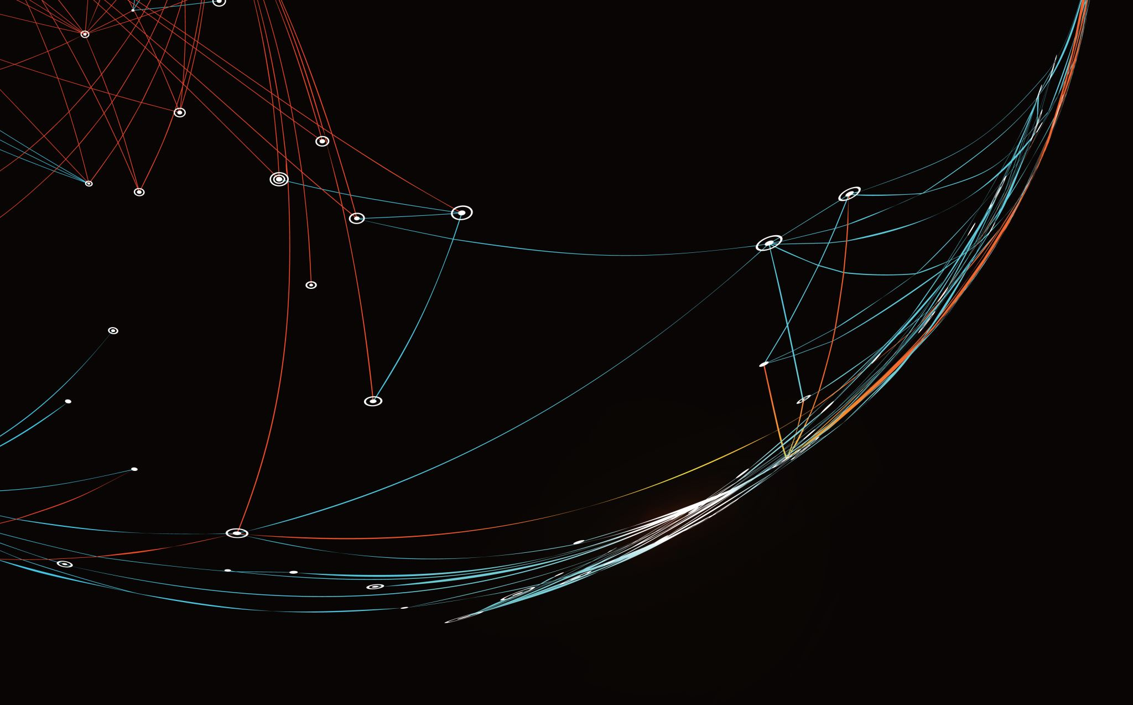
Security Assessment and Risk Management
Week 9 – Regulation and Governance

Slide 2
Getting Sued
This unit we will be talking about different regulations.
When we looked at data breach laws, we saw penalties tended to be pretty low. That’s because the true risk with breaking regulations is civil penalties.
Determining liability is a big part of the risk analysis process.

Slide 3
General personal jurisdiction​
Goodyear Dunlop Tires Operations, S.A. v. Brown and Daimler AG v. Bauman, a company doing business on the Internet may be sued for any reason in the jurisdiction where it is "at home," typically its place of incorporation. This is general personal jurisdiction.
Because general jurisdiction is now quite limited, courts will often look to specific personal jurisdiction to determine whether a company is amenable to suit in each jurisdiction.​

Slide 4
Specific personal jurisdiction​
Allows a defendant to be sued in a forum based on the defendant's contacts with the forum. A court can establish specific jurisdiction over a defendant only if he or she has "certain minimum contacts." .​
“Minimum contacts” for crimes over the Internet mean “active contacts with a forum,” such as Internet sales to the forum residents, conducting business in the forum state through numerous contacts, or entering into specific dealings with forum residents. ​

Slide 5
Minimum Contacts
The United States Supreme Court decided in 1945 in the case of International Shoe v. Washington that for a defendant to be hailed into court in a particular jurisdiction it must have at least a minimum level of contact with that state that it could reasonably expect to be sued in the courts of that state.

Slide 6
Minimum Contacts
Following International Shoe, courts have generally applied a three-part test in evaluating minimum contacts sufficient for jurisdiction:​
(1) The nonresident defendant must do some act or consummate some transaction with the forum or perform some act by which he purposefully avails himself of the privilege of conducting activities in the forum, thereby invoking the benefits and protections[;] ​
(2) the claim must be one which arises out of or results from the defendant's forum-related activities[; and] ​
(3) exercise of jurisdiction must be reasonable.

Slide 7
Calder Test – “Purposeful Direction”
Courts may also apply the "effects" test from Calder v. Jones, 465 U.S. 783 (1984), in cases with insufficient interactivity or minimum contacts, but where an action is targeted at a particular forum.
In Calder, a California resident in the entertainment business sued the National Enquirer, located in Florida, for libel based on an allegedly defamatory article published by the magazine. While the article was written and edited in Florida, the Court found that personal jurisdiction was properly established in California because of the effects of the defendants' conduct in that state.

Slide 8
Purposeful Direction
In the Internet context, the effects test can be used to examine the exact nature of a defendant's Internet activities to determine whether its out of state actions were directed at parties or entities within the forum state. This is referred to in the language of Calder v. Jones as "purposeful direction," which requires:​
(a) an intentional action, that was ​
(b) expressly aimed at the forum state, with ​
(c) knowledge that the brunt of the injury would be felt in the forum state.

Slide 9
Purposeful Direction
If a court finds that a defendant's actions meets the standard of purposeful direction, then personal jurisdiction may be asserted based on Internet activities which do not meet the requisite level of interactivity or minimum contacts needed for other tests of personal jurisdiction in Internet cases.

Slide 10
“Sliding Scale” or “Zippo” Test
In Zippo Manufacturing Co. v. Zippo Dot Com, Inc. Most courts have applied an "interactive-passive" distinction when determining personal jurisdiction over someone operating a Web Site. Generally, courts have conferred personal jurisdiction in cases where "interactive" uses of the Internet have taken place within the state. ​
Interactive contact encompasses two-way online communication which fosters an ongoing business relationship​
“Passive" contacts are those that simply make information available to interested viewers.

Slide 11
Getting Sued
You don’t need to violate any laws or regulations to get sued. This is Murica, you can get sued for anything.
In July 2021, Zoom agreed to pay $85 million to settle a class action suit filed alleging that it violated users’ privacy rights by not providing encryption security, sharing users’ PII without notice or consent with companies such as Facebook, Google etc. and also failing to protect users (and zoom meetings) from unauthorized interruptions (“zoom bombing”).
In addition, Zoom agreed to make some changes to improve users’ security and privacy concerns, including updating its privacy notice to indicate that user data can be shared via third-party software and educating its users about the security features.

Slide 12
Civil Torts
Private parties file suit
Process to determine standing
Burden of proof based on a preponderance of the evidence
No right to silence
No right to attorney
Penalties based on compensation (actual damages) and punitive damages.

Slide 13
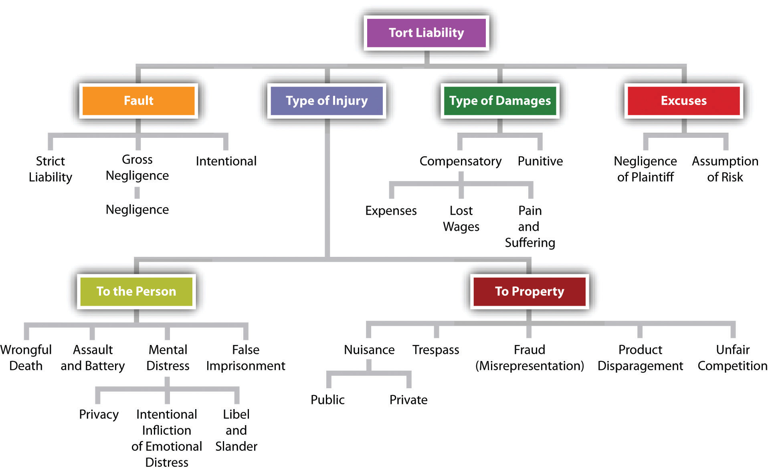

Slide 14
Strict Liability
In both tort and criminal law, strict liability exists when a defendant is liable for committing an action, regardless of what his/her intent or mental state was when committing the action. In criminal law, possession crimes and statutory rape are both examples of strict liability offenses.
In tort law, there are two broad categories of activities for which a plaintiff may be held strictly liable - possession of certain animals and abnormally dangerous activities. Additionally, in the area of torts known as products liability, there is a sub-category known as strict products liability which applies when a defective product for which an appropriate defendant holds responsibility causes injury to an appropriate plaintiff.

Slide 15
Negligence
A failure to behave with the level of care that someone of ordinary prudence would have exercised under the same circumstances. The behavior usually consists of actions, but can also consist of omissions when there is some duty to act (e.g., a duty to help victims of one's previous conduct).
When determining how whether the defendant has breached a duty, courts will usually use the Hand Formula (created by Judge Learned Hand in United States v. Carroll Towing):
If B < PL, then there will be negligence liability for the party with the burden of taking precautions
B=burden of taking precautions
P=probability of loss
L=gravity of loss (gravity of the personal loss, not social loss)

Slide 16
Subpoenas
Subpoena ad testificandum
Order to Preserve / Litigation Hold / Subpoena duces tecum
Administrative subpoenas
Notes:
the duty to preserve evidence arises when the person (or entity) becomes aware of two things: 1) the potential claim; and 2) their possession of relevant evidence.
The purpose of a "spoliation letter" therefore is simply to remove any doubt as to the subject's awareness of those two things. That's all.

Slide 17
Global IT Security Spending
$7.1 Billion in 2014 (Gartner)
8.2% growth to reach $76.9 Billion
Security countermeasures
Firewalls
IDS/IPS
Security Software
Network security appliances

Slide 18
Collecting SBI (Security Business Intelligence)
The implementation of these network security appliances will reduce the attack surface, but will not provide SBI without a comprehensive Information Systems Audit program.

Slide 19
Business Challenge
Identify the need to protect information
Determine the proper access level for administrators and users
Implement and enforce the resulting policy
Monitor the information collected

Slide 20
What exactly is Auditing and IS Auditing?
Information Systems Audit refers to any audit that encompasses wholly or partly the review and evaluation of automated information processing systems, related non-automated processes and the interfaces among them.
Notes:
The most common definition is in the financial industry
An official examination and verification of accounts and records of financial accounts.

Slide 21
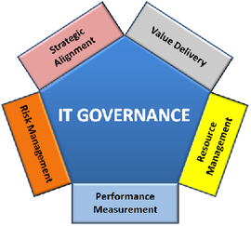
IT Governance, Risk and IS Auditing
Ensuring an enterprise’s strategic objectives are not jeopardized by IT failures.
Notes:
The biggest challenge with IS Auditing is enumerating the delivery of value through IS Auditing. SBI - This discussion goes beyond compliance, there are various benefits in having a robust auditing program.

Slide 22
Proper log configuration
The first step begins with the proper configuration management of the system’s log settings.
Having access to event information will provide the ability to discover and investigate suspicious system, security or application activity.
The success of the IS Audit program will depend on the quality of the analysis and review of the logs.

Slide 23
NIST Objectives for Audit Trails
Individual Accountability
Alerting users that they are personally accountable for the actions.
Reconstruction of events
This can be used to troubleshoot problems and determine if the problem was triggered by the user or the system.
Intrusion detection
This refers to the process of identifying attempts to penetrate a system or unauthorized access.
Notes:
http://csrc.nist.gov/publications/nistbul/itl97-03.txt
SP800-92

Slide 24
The need for auditing
No matter how small or how complex a system is, how can you be certain and confident on your security program unless someone is properly monitoring it?

Slide 25
Comprehensive IS Auditing
Audit account logon events
Audit account management
Audit directory service access
Audit object access
Audit policy change
Audit privilege use
Audit process tracking
Audit system events
Notes:
Audit account logon events – audit each instance of a user logging on to or logging off from another computer in which this computer is used to validate the account. This event category is applicable to domain controllers only since DC’s are used to validate accounts in domains.
Audit account management – audit each event of account management on a computer. Examples of account maintenance include password changes, user account and group modifications.
Audit directory service access – audit the event of a user accessing an Active Directory object that has its own system access control list (SACL) specified.
Audit object access – audit the event of a user accessing an object that has its own system access control list (SACL) specified. Examples of objects are files, folders, registry keys, printers, etc.
Audit policy change – audit every incident of a change to user rights assignment policies, audit policies, or trust policies.
Audit privilege use – audit each instance of a user exercising a user right.
Audit process tracking – audit detailed tracking information for events such as program activation, process exit, handle duplication, and indirect object access.
Audit system events – audit when a user restarts or shuts down the computer or when an event occurs that affects either the system security or the security log.
https://www.petri.com/windows_auditing

Slide 26
Sarbanes-Oxley 15 U.S. Code Chapter 98
The Sarbanes-Oxley (SOX) requires organizations to prove their cybersecurity credentials.
Applicability:
SOX applies only to public companies. Generally, a public company is listed on a public stock exchange. The purpose of the legislation and regulations is to make sure these companies produce accurate financial statements from public companies.
Penalties and enforcement:
SOX has very tough penalties. Unlike many other cybersecurity or privacy statutes, SOX has criminal penalties. In theory, a CEO or CFO can be liable for maximum fines of $1 million and 10 years imprisonment for false certification and $5 million and 20 years for a willfully false filing.

Slide 27
GLBA: Gramm-Leach-Bliley Act 15 U.S. Code Subchapter I
The Gramm-Leach-Bliley Act (GLBA) is both an information security and a privacy law.
Applicability:
The law applies to financial institutions, but the definition is very broad and includes banks, insurance companies, securities firms, non-bank mortgage lenders, auto dealers, and tax preparers.
There is a Security Rule and a Privacy Rule. The Security Rule (16 CFR Part 314) requires organizations to “develop, implement, and maintain a comprehensive information security program that is written in one or more readily accessible parts and contains administrative, technical, and physical safeguards that are appropriate to your size and complexity, the nature and scope of your activities, and the sensitivity of any customer information at issue.” (15 USC §6801 (a))
Penalties and enforcement:
Penalties for violation could exceed $1 million. There is also the possibility of termination of FDIC insurance, which could mean the end of the business for a financial firm.

Slide 28
FTC: Federal Trade Commission Act §5 15 U.S. Code § 45
FTC Act Section 5 is an information security regulation (which requires appropriate cybersecurity measures) and a privacy law.
Applicability:
The law applies to almost every organization in the US, except for banks and common carriers.
Penalties and enforcement:
The FTC is not shy about imposing civil liabilities, which have even reached $5 billion in the recent case concerning Facebook. It might seem odd that a law passed in 1914 to prohibit unfair or deceptive acts is one of the major sources of cybersecurity and privacy law in the US.
How to comply with the FTC:
The problem is that organizations must engage in all “reasonable and necessary” security practices, but these are generally undefined. The FTC has established a regulation, the Safeguards Rule (16 CFR 314), for companies within its jurisdiction that have to comply with the GLBA. This rule is the same as the Security Rule. It would be a good start to determine a company’s responsibilities under the Act.

Slide 29
HIPAA: Health Insurance Portability and Accountability Act 45 CFR Part 160, 45 CFR Part 164
HIPAA has security, privacy, and breach notification rules.
Applicability:
The law applies to health care providers, health plans, health care clearinghouses, and, in some instances, business associates of these businesses called covered entities.
As a result, the Act can cover organizations as diverse as health insurance companies and pharmaceutical companies. Unlike other laws, HIPAA has particular rules to determine compliance.
Penalties and enforcement:
Fines depend on the nature and extent of the violation and, the extent to which the organization has attempted to protect information.
The largest fine to date was more than $16 million. Penalties have been increasing dramatically recently. In 2018 the total number of penalties reached a record $28 million.

Slide 30
COPPA: Children’s Online Privacy Protection Act 15 U.S. Code Chapter 91, 16 CFR Part 312
COPPA is a privacy and cybersecurity law.
Applicability:
COPPA applies to websites and online services that are directed at children under the age of 13. It also applies if the site poerator has actual knowledge that children under the age of 13 are using a website.
The Act's purpose is to regulate how these websites collect, use, and/or disclose personal information from and about children.
Penalties and enforcement:
The Act is enforced by the FTC. Fines have been increasing, with the largest penalty to date reaching $5.7 million.

Slide 31
ECPA and SCA: 18 U.S. Code Chapter 119 and 18 U.S. Code Chapter 121
The Electronic Communications Privacy Act (ECPA) and the Stored Communications Act (SCA), also known as the Wiretap Act, are privacy statutes.
Applicability:
Originally designed to limit warrantless surveillance, these acts forbid the intentional use, disclosure, or access to any wire, oral, or electronic communication without authorization.
Penalties and enforcement:
The acts provide criminal penalties that could be used to jail malicious hackers. They also provide a private right of action.
How to comply with the ECPA and SCA:
Policies should prohibit recording or disclosing any oral or electronic communications without obtaining consent from both parties
Policies should prohibit surveillance of non-employees unless there is consent
Policies allow surveillance, including video and email interception of employees, if there is a valid business reason for doing so

